Slide 1
SPOTIFY GENRE RECOMMENDATION BASED ON USER EMOTION BY USING DEEP LEARNING under the guidance: Dr. SELVAM.L
SUHASINI V : RA2232014010101

Slide 2
ABSTRACT
This paper introduces an innovative deep learning approach for musical recommendation that uses facial recognition technology to personalize musical experiences.
The system analyzes real-time facials to determine an individual's emotional state and dynamically adjusts musical compositions accordingly.
The system generates melodies tailored to the user's mood, creating uplifting tunes for happy moments and soothing melodies for sad ones. This personalized music enhances emotional well-being, promoting relaxation, emotional release, and motivation.
The music reflects the user's feelings, providing a unique musical recommendation experience tailored to their emotional needs. Facial recognition in musical recommendation could revolutionize emotional well-being and psychological support through music.

Slide 3
INTRODUCTION
Deep learning and healthcare are coming together to improve personalized treatments. One exciting use is using facial recognition and Convolutional Neural Networks (CNN) to enhance musical recommendation for emotional well-being. By employing CNN algorithms, this innovative approach seeks to dynamically tailor musical compositions to individuals' emotional states in real-time, based on the analysis of their facials.
This introduction explores how integrating CNNs into musical recommendations can create personalized, emotionally resonant experiences to enhance its therapeutic impact.
Integrating CNN algorithms with facial recognition revolutionizes musical recommendation by enabling adaptive music that responds to users' emotions, unlike traditional static playlists. This approach offers dynamic and personalized therapeutic experiences.
This introduction explores the potential of using CNN-based facial recognition to enhance musical reommendations, emphasizing its ability to personalize and improve emotional support through music.

Slide 4
EXISTING SYSTEM
In the existing system of music genre recommendation, traditional methods often rely on user ratings, listening history, or manually curated playlists to suggest music genres.
These systems may lack the ability to accurately capture the user's current emotional state, leading to less personalized recommendations.
The reliance on manual input or basic algorithms can limit the system's adaptability and effectiveness in providing emotionally resonant music choices for users.

Slide 5
PROPOSED SYSTEM
The proposed system aims to revolutionize music genre recommendation by leveraging deep learning techniques to analyze user emotions in real-time.
Using facial recognition and Convolutional Neural Networks (CNN), the system will detect and interpret the user's emotional state from facial cues.
This emotional data will then be used to recommend music genres that align with the user's current feelings, providing more personalized and emotionally tailored music suggestions.
The integration of deep learning allows the system to adapt and evolve with the user's emotional fluctuations, ensuring dynamic and relevant music recommendations for enhanced emotional well-being.

Slide 6
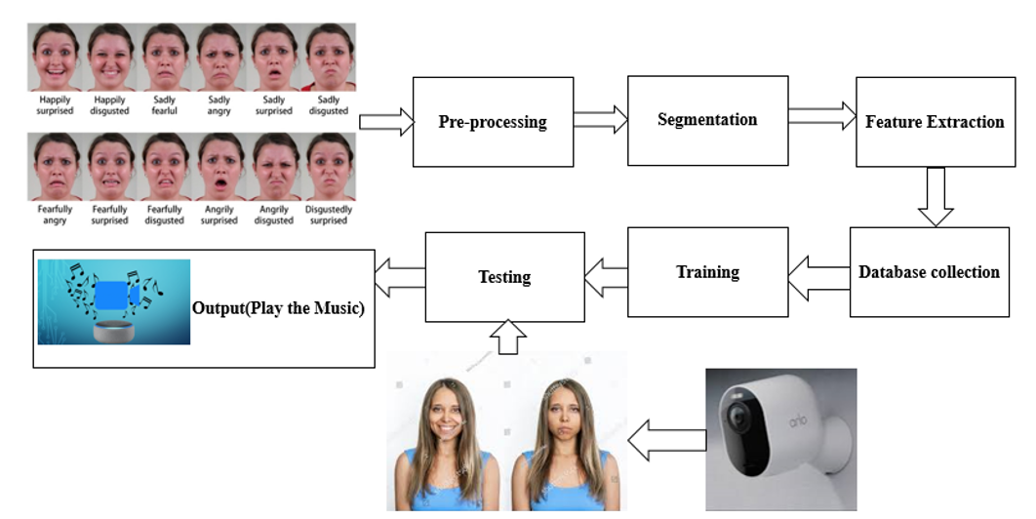
ARCHITECTURE

Slide 7
MODULES
Dataset collection
Preprocessing
Feature extraction
Database
Music generation Module
Testing with result and analysis

Slide 8
MODULE DESCRIPTION
DATA COLLECTION:
The data collection module gathers facial data from video or image recordings, capturing a range of emotions like joy, sadness, anger, and surprise. Quality and diversity of collected data are essential for training accurate recognition models.
PREPROCESSING:
The preprocessing module prepares facial data for analysis by performing tasks like face detection, alignment, noise reduction, and data augmentation. It ensures the data is formatted correctly and enhanced for further processing.
FEATURE EXTRACTION:
Feature extraction identifies key facial features or descriptors using techniques like facial landmark detection and texture analysis. It transforms raw facial data into meaningful feature vectors for input into the recognition model.

Slide 9
MODULE DESCRIPTION
DATABASE:
The database module stores and organizes facial data, both raw and preprocessed, efficiently facilitating data retrieval for system operations. It may also contain metadata for easy data annotation and management.
MUSIC GENERATION MODULE:
The music generation module creates or adjusts musical compositions based on recognized facials, dynamically altering musical elements like tempo, melody, and harmony to reflect the user's emotional state.
TESTING WITH RESULT AND ANALYSIS:
The testing module assesses the system's facial recognition accuracy and the impact of generated music on users' emotions through experiments. Results analysis identifies system strengths and areas for improvement, guiding future development.

Slide 10
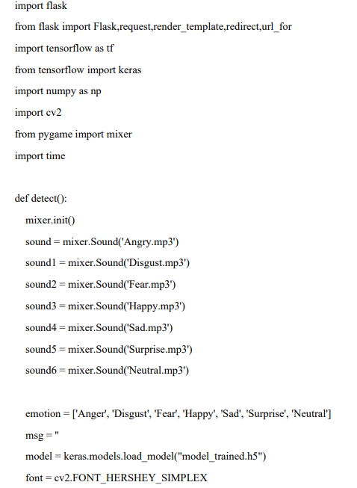
SCREEN SHOT

Slide 11
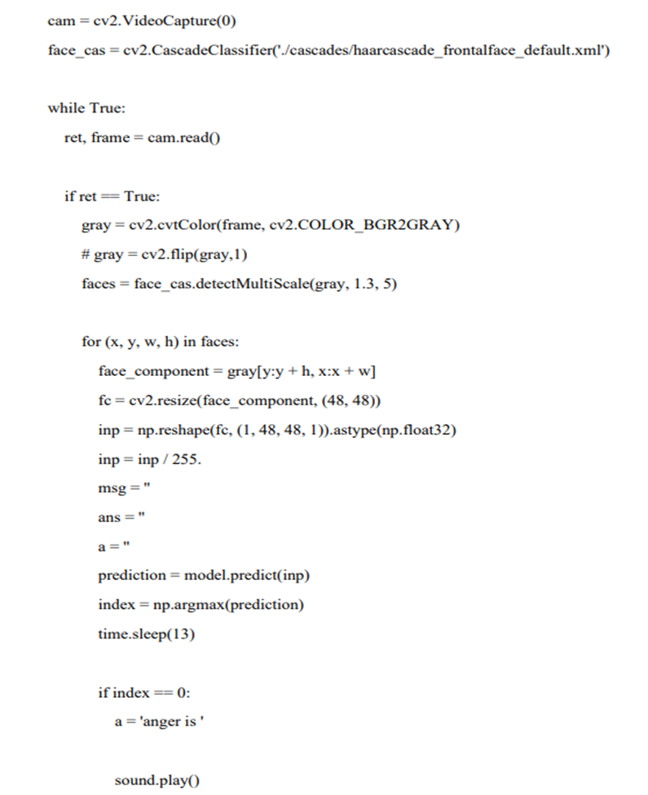

Slide 12
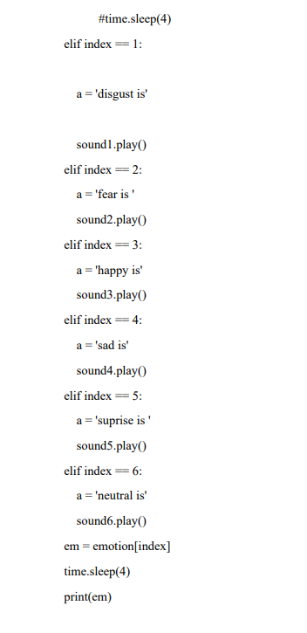
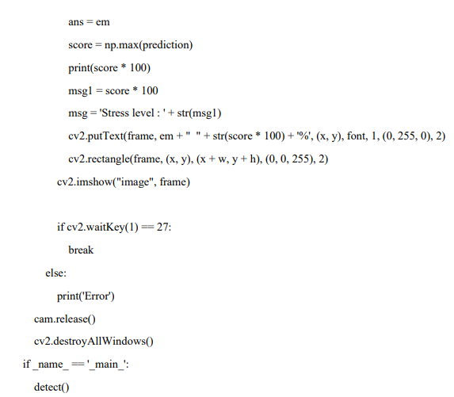

Slide 13
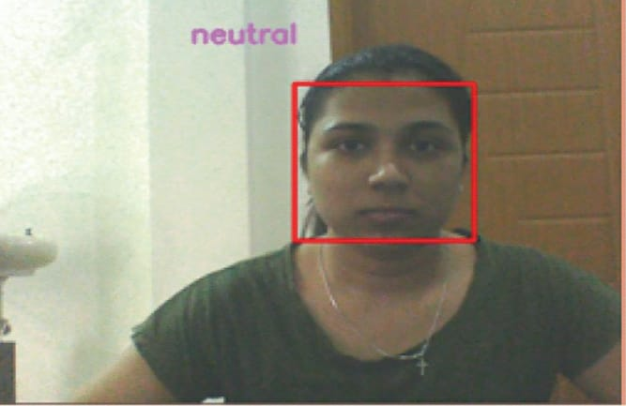
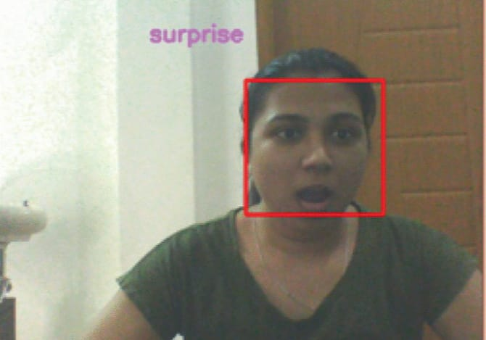
OUTPUT

Slide 14
CONCLUSION
In conclusion, integrating CNNs into facial recognition for musical recommendations has the potential to revolutionize the field by creating personalized, dynamically adaptive musical experiences. This innovation synchronizes music with the user's emotional state, enhancing its therapeutic impact and fostering relaxation, emotional release, and motivation. As research progresses, this fusion of facial recognition and CNN-powered musical recommendation offers a promising approach to improving emotional well-being and providing tailored support.

Slide 15
FUTURE WORK
Future work for the Music recommendation system involves optimizing the CNN model for better performance in emotion prediction and exploring multi-modal fusion techniques to incorporate additional data sources, such as text or physiological signals. Long-term user modeling can be developed to adapt recommendations as users' emotional preferences evolve, while enhanced user interaction mechanisms and cross-cultural adaptation can further refine the system's accuracy and relevance. Incorporating explainability and transparency into the recommendation process will build user trust, and real-world deployment and evaluation will validate the system's effectiveness and user satisfaction, guiding further refinement and improvement efforts.

